Slide 1

Brief Introduction of Java 7
Subtitle
Notes:
To change the image on this slide, select the picture and delete it. Then click the Pictures icon in the placeholder to insert your own image.

Slide 2
Contents
Introducing Java 7
NIO2

Slide 3
Title and Content Layout with Chart
The Java language
“A Brief, Incomplete, and Mostly Wrong History of Programming Languages.”
-- James Iry

Slide 4
Two Content Layout with Table
The Java Platform

Slide 5
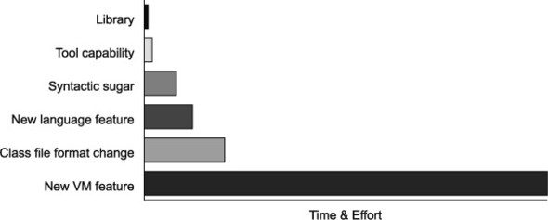
Project Coin
The goal of Project Coin is to determine what set of small language changes should be added to JDK7. (After discussion, 5 out of 70 proposals were selected for JDK7)
Java7 is the first version developed in an open source manner

Slide 6
Project Coin Proposal Judgement Rules
Submit a detailed proposal form describing their change (which should fundamentally be a Java language change, rather than a virtual machine change)
Discuss their proposal openly on a mailing list and field constructive criticism from the other participants
Be prepared to produce a prototype set of patches that could implement their change

Slide 7
Add a Slide Title - 4
Project Coin brought six main new features to Java7:
Strings in switch
Enhanced syntax for numeric literals
Improved exception handling
Try-with-resources
Diamond syntax
Simplified varargs method invocation

Slide 9
NIO2 - Path
The concept of a location - the Path class is a programmatic representation of a path in the file system
JVM only binds a Path to the physical location at runtime
This interface extends Watchable interface so that a directory located by a path can be registered with a WatchService and entries in the directory watched.

Slide 10
NIO.2 - Path
Useful methods (Most of these methods don’t require that the file corresponding to the Path exists.):
getFileName()
getName(index)
getNameCount()
Subpath(start index, end index)
getParent()
getRoot()

Slide 11
normalize()
toAbsolutePath
toRealPath() combines toAbsolutePath() and normalize() and could resolve symbolic links. This method will check the existence and availability of the file.
resolve()
relativize()
Support equals, startsWith and endWith
Path also implements the Iterable. You can iterate over the name elements in the path through iterator.

Slide 12
NIO.2 – File Attributes
FileAttribute
PosixFilePermission

Slide 13
NIO.2 – Working with Directory

Slide 14
NIO.2 - glob
You can use glob syntax to specify pattern-matching behavior.

Slide 15
NIO.2
Be careful when writing filesystem-specific code. Always ensure that your logic and exception handling covers the case where your code might run on a different filesystem.

Slide 16
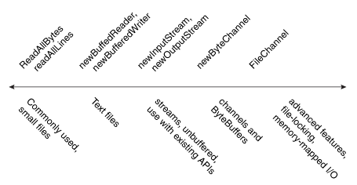
Reading and writing files
Provide bridge to io
BufferReader and BufferWriter
InputStream and OutputStream
Provide new reading and writing
Files.readAllLines

Slide 17
NIO.2 – Reading and writing Files
For small Files:
Files.readAllBytes(Path)
Files.readAllLines(Path, Charset)
Files.write(Path, byte[])
Files.write(Path, Iterable<? Extens CharSequence>)
Buffered I/O for text file:
Files. newBufferedReader(Path, Charset)
Files. newBufferedWriter(Path, Charset, OpenOption...)
Interoperable with Streams:
Files. newInputStream(Path, OpenOption...)
Files. newOutputStream(Path, OpenOption...)

Slide 18
NIO.2 – Channels and ByteBuffers
Channel I/O reads a buffer at a time. The ByteChannel interface provices basic read and write functionality.
Example: SeekableByteChannel – a ByteChannel that can maintain a position in the channel and to change the position.
The newByteChannel methods return an instance of a SeekableByteChannel. With a default file system, you can cast this seekable byte channel to a FileChannel providing access to more advanced features such mapping a region of the file directly into memory for faster access, locking a region of the file so other processes cannot access it, or reading and writing bytes from an absolute position without affecting the channel's current position.

Slide 19
File change notification
Event notification: This class uses client threads to keep an eye on registered files or directories for changes, and will return an event when a change is detected.
Good to replace polling mechanisms

Slide 20
Use WatchService to monitor directory:
Watchable object
WatchKey
A watch service is safe for use by multiple concurrent consumers. To ensure that only one consumer processes the events for a particular object at any time then care should be taken to ensure that the key's reset method is only invoked after its events have been processed.
ready—(event happen)->signaled—(reset)->ready
The key remains valid until:
1. It is cancelled, explicitly, by invoking its cancel method, or
2. Cancelled implicitly, because the object is no longer accessible, or
3. By closing the watch service.

Slide 21
Asynchronous I/O Operations
Paradigms
Future
Callback

Slide 22
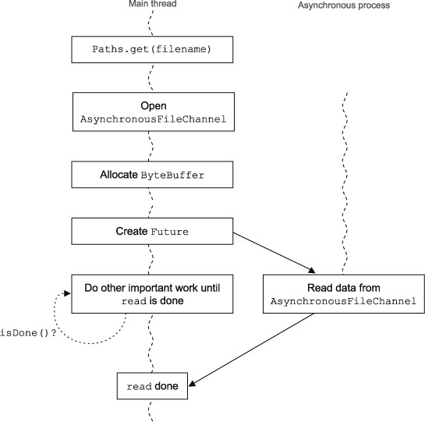
Future
You’ll typically want a Future style of asynchronous processing if you want your main thread of control to initiate the I/O and then poll for the results of that I/O.

Slide 23
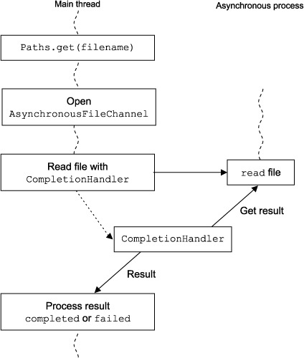
Callback style
This style is typically used when you want to immediately act upon the success or failure of an asynchronous event.

Slide 24
References:
https://docs.oracle.com/javase/tutorial/essential/io/index.html
https://www.safaribooksonline.com/library/view/the-well-grounded-java/

